Slide 1
AI & ML AUDIO SEPARATION
OD91IIITK
~Hassan Muahmed Ahsan A.Ankith Reddy
118cs0036 118cs0034

Slide 2
Tensorflow Model
We have built an ANN Model by training with Urban Audio Dataset.
It can classify the sounds(noises) into ten categories.
Dataset: https://urbansounddataset.weebly.com/download-urbansound8k.html
The model has an accuracy of 91% in training data and 90% in validation data.

Slide 3
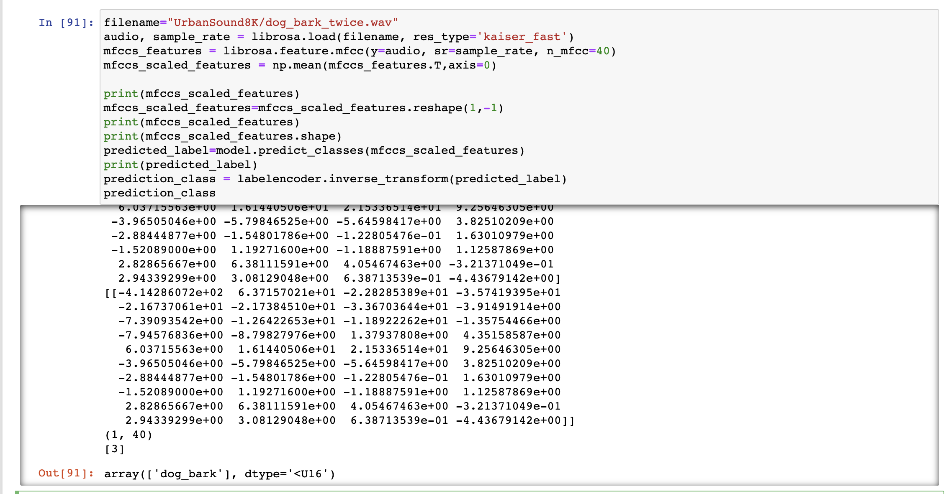
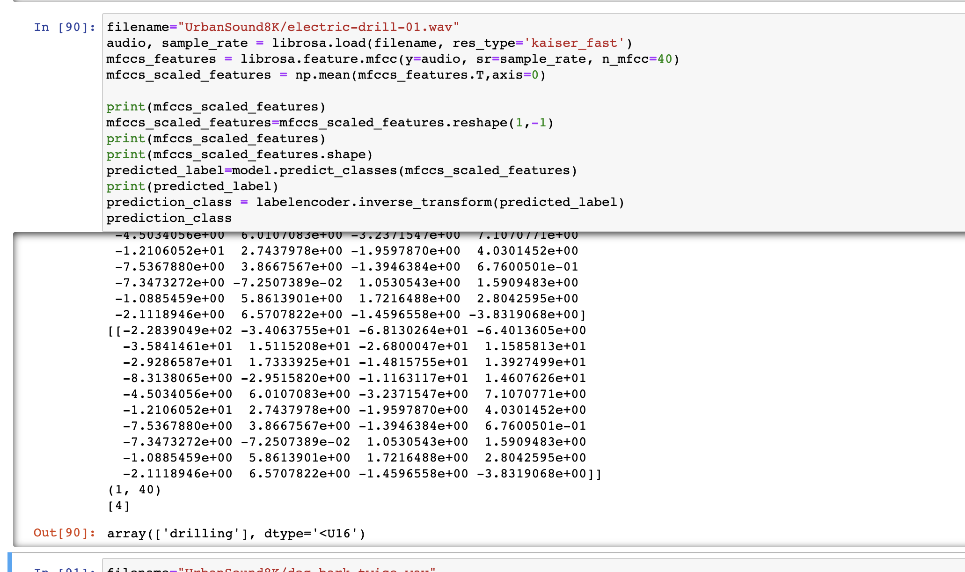
Output

Slide 4
Problems
1. We are unaware of the specific categories we need to classify the sound into.
2. We need the dataset required for building the model.

Slide 5
MAKING OF MUSIC PLAYER
For making the app, I have learned Java and working of the Android Studio.
Started working on the from 5th June.
Made progress in from 3rd week of June

Slide 6
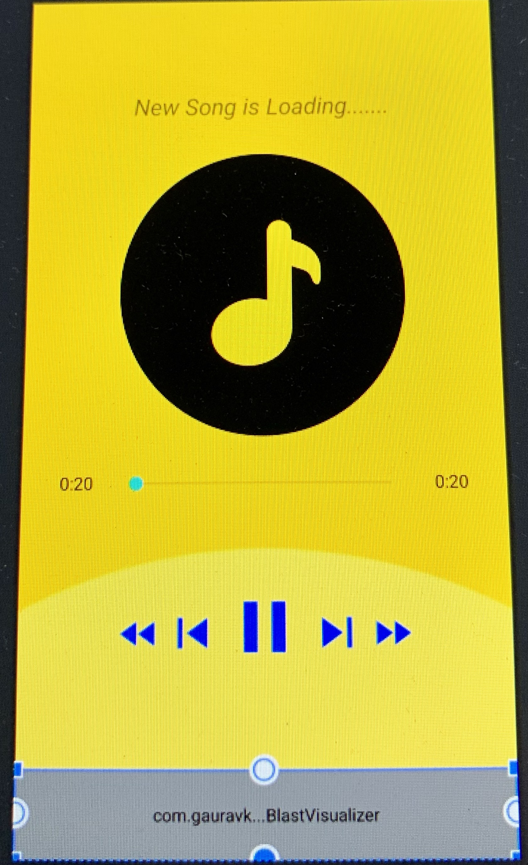
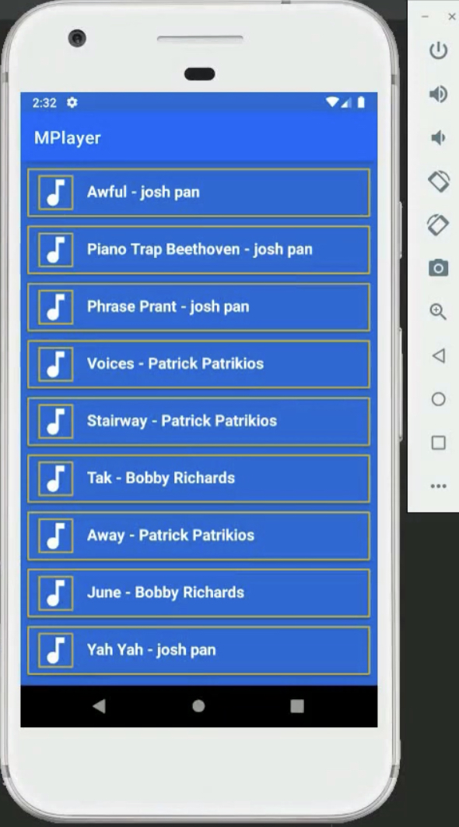

Outline of the App
This is what it will look when you a song
In the place of new song is loading will be replaced by name of the current playing song.
In the process of making this app we will be asking permission from the user

Slide 7
Problems
Their are many bugs that we are facing in the app.
After taking user permission the app crahses.
Intergation of Tensorflow with App.

Slide 8
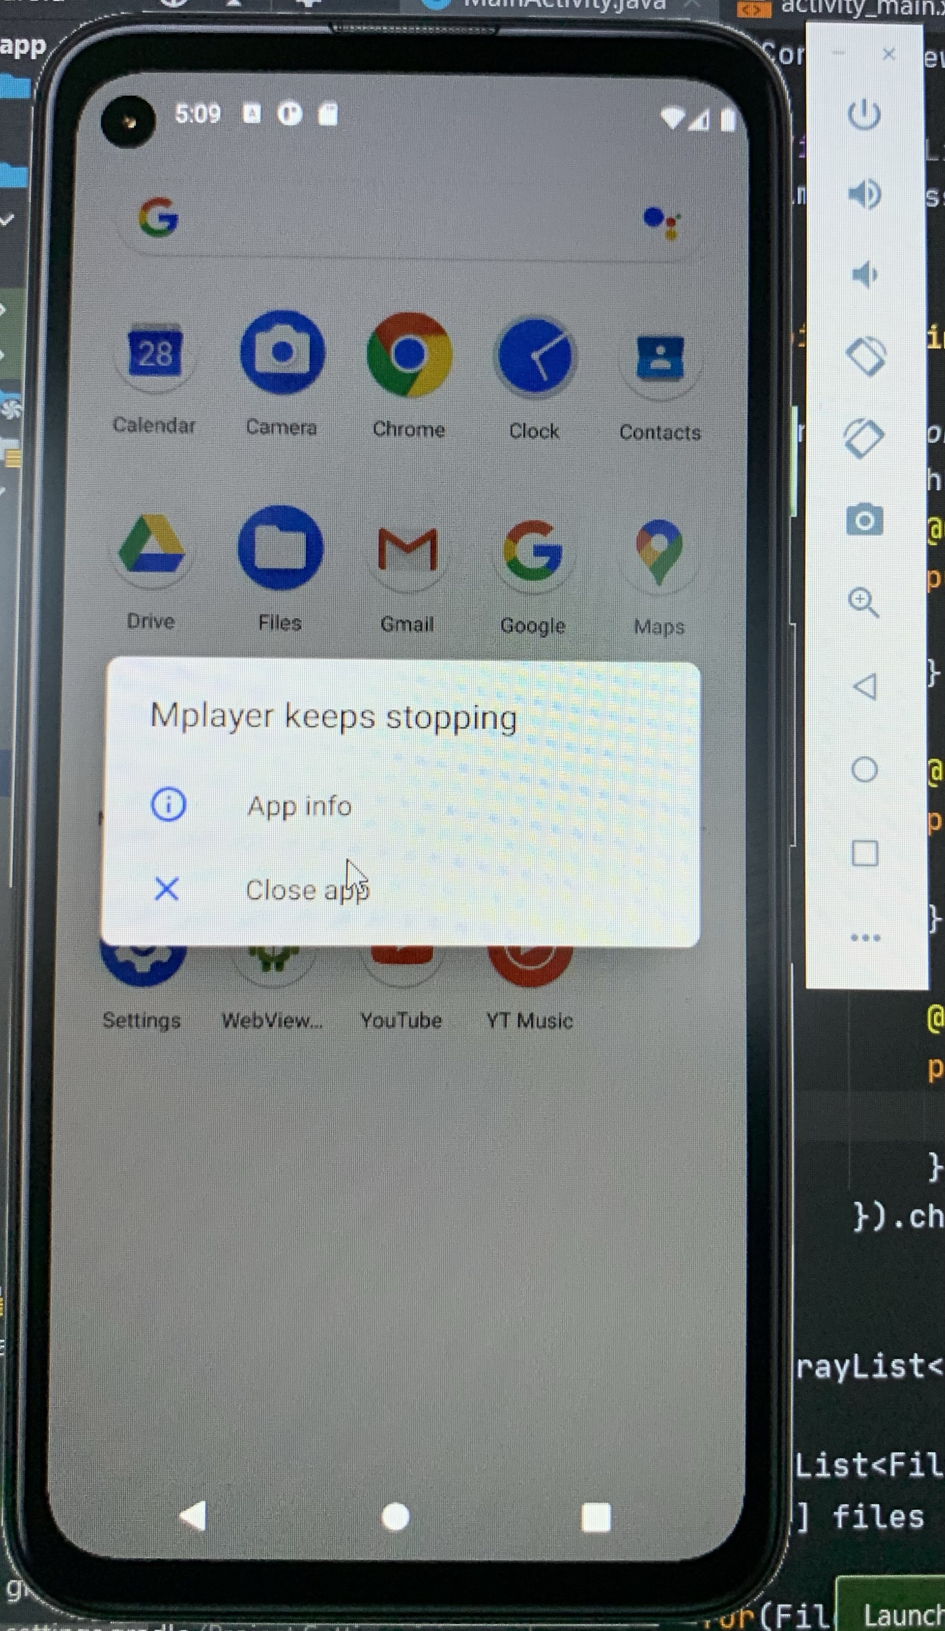
PROBLEMS
The app is based on Java, due to some changes made in the it keeps getting crashed

